Slide 1



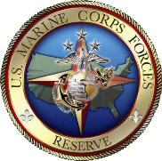
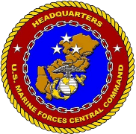







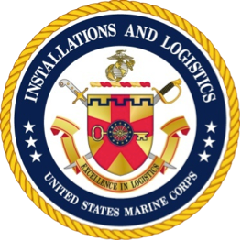

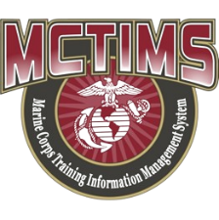







Marine Corps Task List
Mission Essential Task List
MCTL / MET / METL
Life Cycle Development
Process
JUL 2026
HQMC CD&I
Capabilities Development Directorate
Total Force Structure Division
MCTL Branch

Slide 2
Overview
MCTL Branch Mission = Life Cycle Authoritative “Data Driven” Deliverables
Mission Planning, Requirements, MET-based Capabilities, Force Readiness
METs within the DoW Planning, Programming, Budgeting & Execution (PPBE) Process
MCT-to-MET-to Joint Staff MET Alignments
MCTL: The Dictionary of Current Capabilities; MET Building Blocks
CD&I’s Policies and Processes Alignments = MCT-to-MET/METL Workshop Process Deliverables:
  Mission Statement; MET standards Development (“Baseline/Advanced” Capability Statements; Manning/Training/Equipment and Output Standards)
MET-to-Training and T&R Manual Alignments, New MCT or Change Recommendations
MET Standards Development Examples, Authoritative Data Source (ADS) System Repositories, Product Staffing, Approvals, Validation
MET/METL Products Development – What is involved to support the Global Force Management (GFM) Process, Institutional Readiness WG (IRWG), and Quarterly Readiness Brief to CMC (QRB)
MCTL/MET/METL Life Cycle Products Info and POCs and Detailed Backups

Slide 3
CD&I / CDD
Total Force Structure Division
MCTL Branch Mission
DIRLAUTH per MCO 3500.26B (MCTL)
For development of defined content of capabilities/actions/activities expressed as Marine Corps Tasks (MCTs) resident within the Marine Corps Task List (MCTL) and Service Authoritative Database Source (ADS) System MCTIMS interfacing data to DRRS.
For ensuring MCTs are doctrine-based, provide accurate definitions, and represent all elements of the MAGTF.
DIRLAUTH per MCO 3500.110 (METL Development) (MAJOR REVISION 2024-2027)
Codifies Mission-Essential Task/Task List (MET/METL) and associated man/train/equip standards and outputs data development process.
Data represents “as-is” Current Force capabilities; used to develop “to-be” Future Force capabilities.
MET development includes criteria and scale to produce standards to achieve capability outputs assessed for mission support required for MET-based readiness reporting.

Slide 4

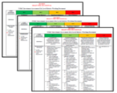

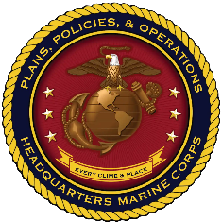


MCT / MET / METL Integrated Life Cycle
CURRENT Force Capability Requirements: Core/OPLAN/Assigned Mission
FUTURE Capabilities: Future Force Design
Current Deployable and Ready Mission Forces METs/METLs
USMC READINESS
DRRS Enterprise
MCTL “Tasks” = METs / METLs (MCTIMS)
Structure = Mission Statement and T/O&E (TFSMS)
Training = T&R Manual (MCTIMS)
Baseline/Advanced Performance Standards
Man / Train / Equip / Output
USMC Missions
Requirements
Capability Development Structure & Resources
Education
POIs
Training
RFFs / RFCs – Force Sourcing of Established USMC Current Capabilities
Mission Readiness Assessments
“Ready Force”
Mission Planning + Requirements + Capabilities + Resources =
Sourcing the Force and Reporting FMF Readiness in DRRS

Slide 5
MCTs/METs/METLs, Capability Development Processes and PPBE**
NSS
NDS
NMS
39th CMC** CPG
Operating & Functional Concepts Development
CURRENT METs/METLs
DPG
QDR
FUTURE
Capabilities = “MCTs/METs”
Force Development & Integration Strategic Plan
PP&O and P&R Reviews Readiness Assessments
GOALS:
--Identify capability deltas, gaps and identify solutions via DOTMLPF/C process and Future Force capability development initiatives to improve FMF METs and associated standards, or, that aids in developing “Future” MCTs/METs.
--Ensure “CURRENT” capabilities (“METS”), supports “FUTURE” concepts and capabilities planning; ensure requirements development cycle produces feasible man/train/equip resources to achieve mission.
Force Design Annual Report (FDAP)
PB-27
FY-32+
CD&I / CDD, OAD and MCWL
Assessment
Guidance
End of FY
Force Development
The Balanced Force:
High Quality People
Unit Readiness
Capability & Capacity to meet requirements
Equipment Modernization
Infrastructure Sustainment
METs / METLs
DRRS-MC
MCCRL
MAGTF Wargames
OPFOR / SE
Execution
MCGL
POM-30
CD&I / CDD
PB-27-28
MCSDD
Planning
Front End Assessment
FIP
CD&I / CDD (TFSD)
CD&I “PLAN”
Program Reviews
Budgeting
Programming
= MROC
= CMC/DoW
POM
POM-29
= Document
FY-27-28
P&R
MARCORSYSCOM
= Transition
P&R
Inside=Output; Outside=Input
** “Accelerate and streamline Marine Corps modernization….
Simultaneously, our ability to rapidly respond to current Global crises must be maintained.”
Gen. Eric M. Smith, 39th CMC (2023)

Slide 6
MCT / MET Alignments/Linkages
JMETs/JMETL
Reported in DRRS-S (DoW / JS / OSD / Chairman’s Readiness System)
Links to Service Components METs/METLs
Supported
CCMD/CCDR
USMC METL
MARFOR
SN 5.3.5.3.1 Provide Forces – OPLANs/CONPLANs (UJTL)
“Tasks”/METs link
Top Down / Bottom Up
ISO HHQ, CCMDs Reported in DRRS
MEF/MEU/MEB
Marine Division
MCT 1.1.2 Provide Task Organized Forces
MCT 1.6.4 Conduct Defensive Ops
Infantry Regt HQ
MCT 5.7.4 Plan and Direct Defensive Ops
Infantry BN
(SPMAGTF)
(AA Teams)
MCT 1.6.4 Conduct Defensive Ops
Installations / Bases / Stations METLs provide Supporting Establishment Infrastructure, Warfighter and Family Support Programs
MCT 2.11 Maintain Multi-Domain Awareness
MCT 4.6.2.4 Provide Communications/Information Technology
MCT 4.6.6 Provide Community Services
MCT 4.6.7 Provide Installation Command & Staff Support Services
MCT 4.6.8 Provide Installation Aviation Operations Support Services
MCT 4.6.9 Provide Installation Ranges and Training Areas
MCT 4.6.10 Provide Installation Logistics Support Services
MCT 4.6.11 Provide Installation Protection Support Services
MCT 4.9 Provide Base and Station Facilities and Related Infrastructure
MCT 4.9.12 Provide the Installation Communication Grid (ICG)
MCT 5.5.1 Conduct Interorganizational Cooperation
MCT 5.3.2.1.1 Establish Base OPS Center to Plan, Coordinate, Communicate and Execute Installation Support to National Response Plans
MCICOM Regions
--MCIWest (I MEF)
--MCIEast (II MEF)
--MCIPac (III MEF)
--MCINCR

Slide 7

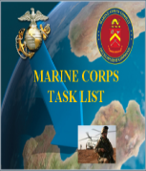
MCTL Supports Current Capability
MET/METL Development
MCTL: “Dictionary” of current USMC activities/actions/capabilities defined as “Tasks” that an organization must perform to accomplish a mission.
MCT’s are used by COI / SE as “Building Blocks” for METs/METLs
MCTs are Organized by the Six (6) Warfighting Functions (WFF):
  Maneuver
  Intelligence
  Fires
  Logistics
  Command and Control
  Force Protection
  Information*
Contains Task Title, Task Definition, Doctrinal Ref and Suggested Measures of Performance
*NEW Warfighting Function
USMC TASKS:
MCT 1.6.1 Conduct Offensive Ops
MCT 1.6.4 Conduct Defensive Ops
MCT 1.10 Conduct Crisis Response
MCT 1.12 Conduct Expeditionary Ops
MCT 1.13.2 Conduct NEO
MCT 1.15.1.2 Facilitate Foreign HA
1. MCT 1.6.1 Conduct Offensive Ops
MCT 1.6.4 Conduct Defensive Ops
MCT 1.10 Conduct Crisis Response
MCT 1.12 Conduct Expeditionary Ops
MCT 1.13.2 Conduct NEO**
MCT 1.15.1.2 Facilitate Foreign HA**
**Not deemed CORE by Community but could be CORE+ for
Assigned Mission / OPLAN METL
EX: INFANTRY CORE METL
Official Tri-Service Directive
OPNAVINST 3500.38C
MCO 3500.26B
USCG COMDTINST 3500.1C
Revised 16 Aug 2018
TASK (MET)
TASK (MET)
TASK (MET)
1
2
3
TASK (MET)
TASK (MET)
TASK (MET)
4
5
6
FMF/Units DRRS Report – 30 Day Interval
SE/Installations DRRS Report - Quarterly

Slide 8
MCTL – What is a Marine Corps Task?
  “Tasks” describe capabilities / actions / activities
  a Unit or Organization must perform to accomplish the mission
        1. Maneuver
        2. Intelligence
        3. Fires
        4. Logistics
        5. Command and Control
        6. Force Protection
        7. Information
Contains Task Title, Task Definition, Doctrinal References and Suggested Measures
EXAMPLE Marine Corps Task
Task Title: MCT 1.12.1 Conduct Amphibious Operations
Definition: To conduct a military operation launched from the sea by an amphibious force, embarked in ships or craft with the primary purpose of introducing a landing force ashore to accomplish the assigned mission. Types of amphibious operations include assaults, withdrawals, demonstrations, raids, and other amphibious operations in a permissive, uncertain, or hostile environment.
Doctrinal References: (JP 1-02, 3-02, MCDP 1-0, 3, MCWP 3-33.7, 4-11.8, MCRP 3-33.7A, MCO 3104.1)
Suggested/EXAMPLE Measures:
M1 Percent Of qualified and deployable MOS Marines available to conduct Amphibious Operations.
M2 Percent Of Mission Essential Equipment (MEE) supply on hand and Mission Ready.
M3 Y/N Able to conduct amphibious ops at MEB level, transitioning MAGTF capabilities ashore from amphib shipping
M4 Y/N Regimental HQ capable of executing C2 throughout all phases of the amphibious operation.
Designed Capabilities of a USMC Unit
or
Functional Support Capabilities of an Installation / Base / Station
Six Warfighting Functions
Notes:
8

Slide 9
MCTs Become Unit METs
MCT
MCT
MCTL: Common reference guide used by USMC commanders, mission planners and unit trainers.
Units derive their “tasks” from MCTL per requirement to report their capability readiness via the MET-based construct within SECDEF Defense Readiness Reporting System (DRRS).
MCTL “Essential/Critical” MCTs for mission accomplishment become Mission Essential Tasks (METs) that align to the COI’s T&R Manual.
Core METs
  Critical, discrete, externally-focused activities that enable execution of the organizational mission; tasks for which standing organizations were designed; standardized for each unit type
Core Plus METs
  Have lower probability of execution; theater specific; NOT included in unit readiness assessments; Units may elect to include Core Plus tasks in their METLs and associated training plans
Assigned/OPLAN METs (CLASSIFIED)
  Developed and assessed when 25% or more of a unit deploys or prepares to deploy ISO a Named Operation; Based on Core METs, Core Plus METs, Mission templates, and deployment guidance
STANDARDS:
Baseline/Advanced Capability Statements
Personnel, Equipment
Training/E-coded Events/Exercises
Outputs
Subordinate/Supporting Unit Elements (if applicable)
MCT
MCT
MCT
MCT
Baseline/Advanced
Readiness Standards
Personnel
Training
Equipment
Exercises
Outputs
Subordinate/Supporting Units
Unit METL
Core Mission
Assigned Mission
Mission Statement
MET
MET
MET
MET
MET
MET
DRRS

Slide 10
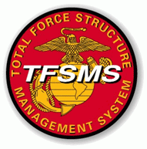


MET / METL Review Workshops Process
(MCO 3500.110**)
**2024-2027 MCO Revision: Modifies 2011 MCO language to address changing roles/responsibilities, required METL development support, and evolving training and readiness reporting advancements.
Policy validates integration between CD&I, TECOM, Stakeholder and FMF COI.
Calling MSG via NIPR DON-ETMS2 announces COI review and participation details.
Mission Statement: Ensures organizational capability and mission intent can be met. Aligns to chosen METs. (Updates are aligned to METs, implemented by TFSD)
Marine Corps Tasks (MCTs): Do defined capabilities/actions/activities continue to satisfy the organizational mission intent? (New MCT recommendations/modifications captured during MET/METL review)
T/O&E: Current data resident within TFSMS aligns to METs/METL.
(MEE and CMOS captured during MET/METL Review. TOECR process ICW COI Principal Advisor and TFSD)
T&R Manual: Training standards, training events/exercises aligned to METs.
(NEW or modified training recommendations captured during MET/METL review)
METL Development MCO aligns to:
MCTL (MCO 3500.26)
Total Force Structure Process (MCO .1E)
MC Readiness Reporting (MCO 3000.13B); GFM policies and processes.

Slide 11
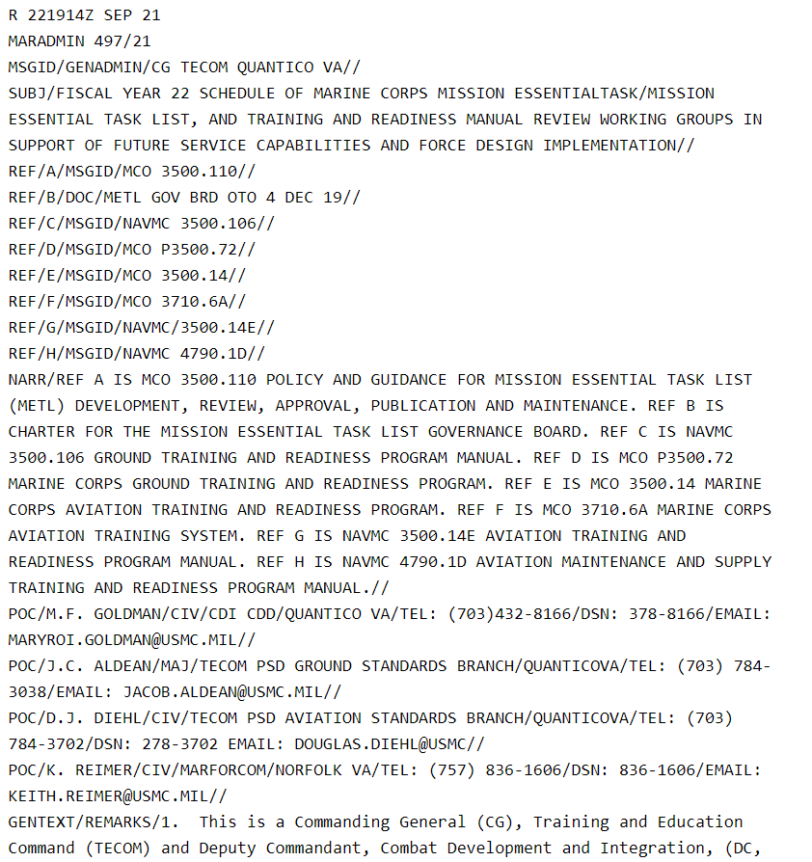
MET / METL Review Process
Review Coordination & Timelines of
Developed Deliverables to Implementation
90 Days: TFSD MCTL/METL Branch contacts Principal Advisor org and TECOM to identify Lead AOs to assist with METL Review and coordinate required METL review info for Calling MSG released via DON-ETMS2.
80-60 Days: TFSD MCTL/METL Branch establishes MSOutlook TEAMS site as repository for review RAHs, current METs/METL and products, leveling info, etc.
60-30 Days: Attendees informs TFSD MCTL/METL Branch participation intent; Roster.
1-5 Days METL WG: TFSD MCTL/METL Branch provides review leveling. Lead Stakeholder AO provides leadership guidance for review. Breakout WG established if required.
7-10 Days Post METL WG: Developed products reviewed by stakeholders for additional refinements. Final refinements provided to TFSD MCTL/METL Branch for institutional staffing.
  14 Working Days: O6 Level staffing via DON ETMS2 conducted.
  14 Working Days: Adjudicates of O6 level comments.
  14 Working Days: GO Level staffing via DON ETMS2 conducted.
  14 Working Days: Adjudication of GO level comments.
TFSD prepares Decision Memorandum for DC CD&I validation of METL products.
METL data modifications made within MCTIMS for immediate interface to DRRS.
MCTL/METL Branch coordinates captured CMOS and MEE change recommendations, if any, with TFSD MAGTF Branch sections and PP&O POR.
MCTL/METL Branch provides TECOM MET/METL approval status allowing necessary community training events and T&R manual refinements to proceed.
CD&I MARADMIN
FY METL / T&R Manual
Review Schedule
CD&I CDD TFSD
MCTL/METL Branch
Stakeholders
PP&O, AVN, I&L, DC I,
SE / MCICOM
TECOM
Annually coordinated with Principal Advisors and TECOM, the Schedule of FMF/unit MET/METL, Training Management Team, and T&R Manual Reviews
FMF Units
PP&O Readiness

Slide 12
MET / METL Review Workshops Process
(MCO 3500.110)
Methodology and Validation Elements
SUPPLIERS | INPUTS | PROCESS | OUTPUTS | CUSTOMERS
Units Installations | Unit w/Designed Capability Mission Statement SE / Installation Support to the Warfighter MCTL Task/s USMC or Joint Doctrine T/O (MOS) & T/E (MEE/PEI) Training Events (E-Coded Individual/Collective) Exercises and CERTS aligned to COI T&R Manuals DoDI – Installation Benchmark and/or Title X Requirements | Process Flowchart Below Policy Controls: DoD DRRS Enterprise Policies MCO 3000.13B DRRS MCO 3500.26B (MCTL) MCO 5311.1E (TFSP) MCO 3500.110 (METL) MCO 1553.10 (MCTIMS) METL Development Workshops Stakeholder Adjudicate Incorporate data into MCTL / MCTIMS / DRRS | List of “Mission Essential” MCTs Baseline/Advance Capability Statements per MET Standards/Criteria Metrics: - P = Personnel - E = Equipment - T = Training - O = Output | Commanders MARFORs/MEFs/ MEUs/MEBs/Units Install/Bases Principal Advisors HQMC / PP&O ** MROC / JROC DoW / SECDEF Congress / POTUS **CD&I CDD Integration Divisions utilize MCTs for Future Capability Development, POM and WIPEB Strategies
Start of MET/METL Review Workshop
Mission guidance from Leadership HHQ
Core design capability of the Unit/Org
Develop and prioritize list of Tasks “essential”
to the Unit/Org mission
Develop Baseline & Advanced Capability Statements per Task
Determine T/O&E required to perform Task
Determine Task Outputs: What capability is being provided ISO Mission? Integrated coordination completed? Time/duration to sustain capability? Enablers?
Determine Subordinate/Supporting Requirements if needed
Identify Training Events necessary to achieve Task performance
METL Products receive ETMS2 O6/GO Staffing/Adjudication;DC CD&I DM Validation
METL Review Workshop Completed
Approved / Validated MET/METL and Standards data updated within MCTIMS for interface to DRRS.
Notes:
12

Slide 13
MCT / MET / METL Development
Mission Statements
Review current unit Mission Statement to ensure alignment to Core METs, or, recommend revision for updating during MET/METL review.
Mission Statements define and describes capabilities (core competencies or operational requirements), the organization, mission, tasks, employment, administrative and logistics capabilities, command and signal. MCO 5311.1E Total Force Structure Process, Appendix B, provides example of Mission Statement format/package necessary to facilitate change:
  Header (i.e., Department of the Navy, HQ USMC, 3300 Russell Rd, Quantico VA 22134)
  UIC or Multiple UICs/Organization Name (Unit Identification Code-M21810 2nd Assault Amphibian BN)
  Promulgation Statement (Briefly outline the organization and content of the continuity of operations plan and describe what it is, who it affects, and the circumstances under which it should be executed.)
  Organization (i.e., HQ & Service Co.; A Company; Engineer Support Co.)
  Mission/Tasks (i.e., MCT 1.1.2 Provide Task-Organized Forces; MCT 1.6.1 Conduct Offensive Operations; etc.)
  Concept of Organization (Briefly explain the unit’s organization and reporting hierarchy; Who the unit reports to)
  Concept of Employment (7 warfighting functions: Maneuver, Intel, Fires, Logistics, C2, Force Protection, Information)
  Admin Capabilities (i.e., How the unit’s administration is carried out and to what extent)
  Logistics Capabilities (i.e., 7 functions of logistics)
  Command and Signal (Briefly explain who the commander of this unit reports to and capability it provides).
  Supersession (Ex: This Mission Statement supersedes the previous Mission Statement and is effective upon receipt)
Units without valid current Mission Statements run the risk of not having submitted TOECR’s considered. Mission Statements are required to validate requested changes.
13

Slide 14
CD&I TFSD Branch Heads
TFSD
Reserve Component
Org Mailbox
SMB_CDI_CDD_TFSD_Reserve@usmc.mil
Branch Head
LtCol. Daniel Green 703-432-8460
daniel.s.green@usmc.mil
MAGTF Branch
Branch Head
LtCol.Romagnoli
703-784-6241
edmund.romagnoli@usmc.mil
Assistant Branch Head
Mr. Anthony McClendon
703-784-4710
anthony.mcclendon@usmc.mil
Supporting Establishment (SE)
Org Mailbox
SMB_CDI_CDD_TFSD_SE@usmc.mil
Branch Head
Ms. Marsha Harris
703-784-6079 marsha.harris@usmc.mil
Navy Branch
Org Mailbox
SMB_CDI_CDD_TFSD_Navy@usmc.mil
Branch Head
Mr. Jason Darby
703-432-8327 jason.darby1@usmc.mil
MCTL / METL
Org Mailbox
SMB_CDI_CDD_TFSD_MCTL@usmc.mil
Branch Head
Ms. Maryroi Goldman
703-432-8460 maryroi.goldman@usmc.mil
Mr. Mario Martinez 703-784-6240
Mr. James Martin
703-784-6046
Mr. Mike Aguirre
703-784-6085
Command Element (CE)
Org Mailbox
SMB_CDI_CDD_TFSD_ CE@usmc.mil
CE Analyst
Mr. Ramon Sanchez
703-784-5720, ramon.sanchez@usmc.mil
Ground Combat Element (GCE)
Org Mailbox
SMB_CDI_CDD_TFSD_ GCE@usmc.mil
Section Head
Mr. Tom Gilbert
703-784-6237
thomas.gilbert@usmc.mil
Aviation Combat Element (ACE)
Org Mailbox
SMB_CDI_CDD_TFSD_ ACE@usmc.mil
ACE Analyst
MGySgt Joseph Smith
703-784-4913 joseph.d.smith@usmc.mil
Logistics Combat Element (LCE)
Org Mailbox
SMB_CDI_CDD_TFSD_ LCE@usmc.mil
Section Head
Maj Robert Grusky
703-784-6202
robert.r.grusky@usmc.mil

Slide 15
MCT/MET/METL and T&R Development
A Collaborative Process
Annual MARADMIN FYXX Schedule of MET/METL, TMT and T&R Manual Reviews, ensures METs/METLs development, refinement and alignment actions synchronize with unit Mission Statements and align to COI T&R Manual training events supporting service capabilities.
Established “Current” MCT / MET / METL capabilities:
What is the unit’s mission requirement? What capabilities can the unit provide NOW?
  Changes or modifications to unit capabilities are addressed during METL review.
What MET-to-training aligned e-coded or chained training events exist NOW?
  New or needed training events are addressed during METL review.
Concept or “Future Force” derived DRAFT MCTs/METs recommendations:
Requires CD&I/TFSD DOTMLPF/C Working Group (DWG) visibility as a possible new initiative tied to a unit. DWG Pillar Leads identify capability requirements.
DRAFT MCTs derived from concepts require doctrine support (i.e., Joint, USMC) to quantify future TTPs, POI, curriculum development, training experimentation, T&R exercises and events IOT determine MET-to-training feasibility.
MCTIMS Task Master Module Modernization:
“Future MCTs/METs” data is NOT interfaced MCTIMS-to-DRRS.
Will be incorporated within MCTIMS as “DRAFT=T-MCTs” to aid training experimentation
A MCT once approved, can be used as a unit readiness reportable MET and aligned to the COI T&R Manual.

Slide 16
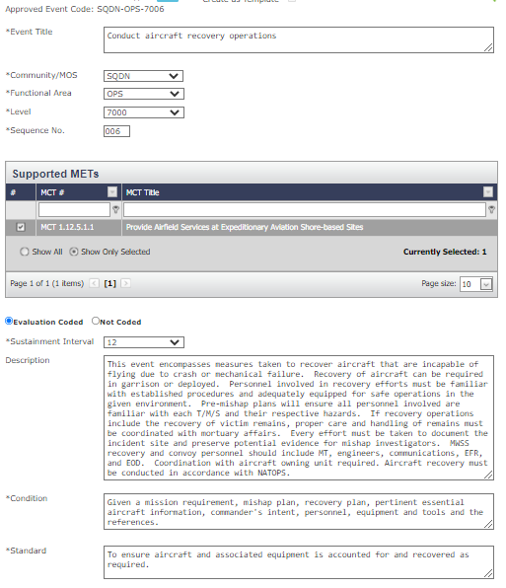
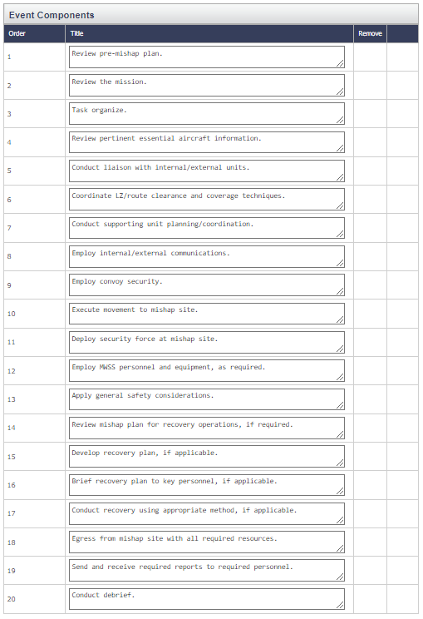
MCT/MET/METL and T&R Development
A Collaborative Process
T&R Event Components
T&R event description, standard, and event components are developed/refined at COI T&R Manual conferences following MET/METL reviews. Data is resident within MCTIMS T&R Manual Module.
METL training standards are reconciled with the updated T&R standards data for interface to DRRS.
16

Slide 17
NEW or Revised MCT Recommendations
REVISED MCT 5.3.5.6 Coordinate Aviation Operations, Fires, and Effects The purpose of fires integration is to fully integrate the Marine Corps combat arms in such a way that in order to counteract one, the enemy becomes vulnerable to another. The Marine Air Command and Control System (MACCS) is responsible for providing the Marine Air Ground Task Force (MAGTF) Commander with the Command and Control (C2) of aviation assets necessary to properly integrate air combat power with ground fires. The Marine Air Support Squadron (MASS) provides the Direct Air Support Center (DASC) for control and coordination of aircraft operating in direct support of the MAGTF by applying Fire Support Coordination Measures (FSCMs) and Airspace Control Measures (ACM) when coordinating aviation operations within the area of operations which would enhance the expeditious attack of targets and provide safeguards for friendly forces.. The DASC coordinates the execution of direct air support missions with other supporting arms through the appropriate Force Fires Coordination Center (FFCC)/Fire Support Coordination Center (FSCC) and, as required, with other appropriate MACCS agencies. (JP 3-09, MCWP 3-16, 3-25.5)
NEW
MCT 5.9.2.1 Conduct Offensive Cyberspace Exploitation
Cyberspace exploitation actions include access creation, military intelligence activities, maneuver, information collection, and other enabling actions required to prepare for future military operations. Cyberspace exploitation supports current and future operations through collection of information, including mapping red and gray cyberspace to support situational awareness; discovering vulnerabilities; enabling joint intelligence preparation of the environment, warning, and joint target development; and supporting the planning, execution, and assessment of military operations throughout the Operating Environment (OE). (CJCSI 3130, CJCSM 3320.01D, 3320.02E, JP 2-0, 3-12, 3-53, 3-60, 3-85, MCDP 8, MCRP 3-30.8, MCWP 8-10, NWP 3-13)
REQUIREMENTS for NEW MCT development:
Content and description of the new MCT must define capabilities, actions or activities.
Does the new MCT have Doctrinal support (i.e., USMC, Joint, other Service pubs)?
Rationale for new MCT addition (i.e., does the task meet HHQ guidance or evolving mission requirements)?
Ensure new Task is addressed at the next community T&R Manual review. Identify what training events are needed.
REQUIREMENTS for MCT Revision:
Crosswalked. Does the MCT revision recommendation potentially affect another COI that may also be using it as a MET for their DRRS report?

Slide 18
Amphibious Readiness Precept
for All METL Reviews
“The Naval Engagement Board (NEB) serves as CMC’s primary forum for the development of coordinated Service positions for naval shipbuilding and all significant Navy/Marine Corps related naval integration….
Focus is to improve, influence, and coordinate within the DON, Office of the Secretary of Navy, and Congress, to influence Amphibious Warfare Ship (AWS), Maritime Prepositioning Ships (MPS), ship-to-shore connectors, and alternative platforms readiness and availability, and to shape amphibious warfare.
The NEB serves as a coordinating body for all senior USMC engagement to increase afloat forward presence for crisis and amphibious operations in crisis and conflict.
DC CD&I is tasked within the NEB Charter:
(12) Establish amphibious readiness as a precept for all METL reviews.
(13) Develop readiness standards with amphibious METs to capture:
  (a) Individual tasks enhanced to include water survival, vehicle egress, and shipboard familiarization.
  (b) Staff tasks enhanced to include amphibious and embarkation planning.
  (c) Collective tasks enhanced to include ship-to-shore maneuver, naval fires, and integration.
DC T&E is tasked within the NEB Charter:
(4) Support CD&I to establish amphibious readiness as a precent for all METL reviews.
(5) Support CD&I to develop Training and Readiness standards that support amphibious MET to capture:
  (a) Individual tasks enhanced to include swimming, vehicle egress, and shipboard familiarization.
  (b) Staff tasks enhanced to include amphibious and embarkation planning.
  (c) Collective tasks enhanced to include ship-to-shore maneuver, naval fires, and integration.”
  ACMC Naval Engagement Board Charter (20 Jan 2026)

Slide 19
MET/METL/Training Review Objective and Products Development
Annual MARADMIN FYXX Schedule of MET/METL, TMT and T&R Manual Reviews, ensures METs/METLs development, refinement and alignment actions synchronize with unit Mission Statements and align to COI T&R Manual training events supporting service capabilities.
MET refinements should be based upon HHQ guidance and current unit shaping actions. Review Checklist:.
  Current Marine Corps Tasks (MCTs) definitions used as METs
    Are MCT actions/activities/capabilities expressed and defined still accurate?
  Current Baseline and Advanced MET Capability statements
  Current Capability Output standards
  Current Training standards – MET-to-Training, aligned to COI T&R Manual
    Are training events adequate, require refinement, need individual, collective, chained training events?
    Staff training events/exercises, Certification requirements and MCCRE considerations?
  Current MET-to-T/O alignments
    Critical MOS identified - necessary to execute the METs
  Current MET-to-T/E alignments
    Mission Essential Equipment (MEE/TAMCNs) - necessary to execute the METs
  Develop amphibious readiness standards
  MET Capabilities Crosswalks (Identify supporting/subordinate unit MET support to HHQ)
  CBRN Training Assessment Intervals
  Community “Observations / Recommendations”
  (Included in METL staffing pkg. to provide SA/visibility to Leadership)
  Chosen or modified METs align with unit’s current Mission Statement?
  If applicable, identify Units of Employment (UE) standards

Slide 20
MET Standards
  Standard: The combination of measures and criteria used to illustrate minimum acceptable proficiency required in task performance.
  FOCUS: Develop standards consistent with capability intent and desired outputs.
Resource:
Manpower (T/O) and Equipment (T/E) required to produce the outputs
Training:
  Each MET should have standards for two (2) levels of trained proficiencies:
        Baseline Capability: Level of readiness expected from a USMC tactical unit, normally sustained through unit Core training at home station and achieved without requiring a Deployment for Training, dedicated at-sea training, or external MAGTF support.
        Advanced Capability: Level of readiness required by specific units expected to perform a critical role in a mission or OPLAN. This level of readiness normally requires external MAGTF support, ship-to-shore movement, or a Service-level or Joint training exercise. Units designated for training to this level are normally selected through the force synchronization process.
  METs align to COI T&R Manuals, individual/unit “E”-coded training events, and exercises/certifications necessary or required to accomplish proficiencies, produce desired outputs and provide trained capability assessments.
Subordinate/Supporting Unit:
Tasks performed by other units that are required to produce the outputs; Required for intermediate level commands

Slide 21
MET Baseline / Advanced Capability Standard Statements
Per CJCSI 3401.02 Force Readiness Reporting
“ Qualified Yes: Unit can accomplish all or most tasks to standard under most conditions.
Specific standards and conditions that cannot be met, as well as the shortfalls or issues impacts the
unit’s inability to accomplish the task. Must be clearly detailed in MET assessment.
Yes: Task accomplished to established standards/conditions.
Assessment: demonstrated via training or ops.
  Challenge: What is “most”? Solution: USMC re-defined assessment process to distinguish between baseline standards (equivalent to “most”) and advanced standards (equivalent to “all”).
USMC NETUSR DRRS
Qualified Yes = Baseline readiness: Level expected from a USMC tactical unit, sustained through unit core
training at home station and achieved without requiring a DFT, dedicated at-sea training, or external
support.
Yes = Advanced readiness: Level of readiness required by specific units expected to perform a critical role
in a mission or OPLAN. This level of readiness requires external support, ship-to-shore movement, or
a Service-level or Joint training exercise. Units designated for training to this level are selected through
the Force Synchronization process.
Considerations for Baseline:
Sustainment at Home Station
Sustained across most of a unit’s lifecycle
No external MAGTF support required (evaluators or attachments)
No dedicated at-sea training required
Considerations for Advanced:
Peer threat
Adversary force used for training
Degraded/denied C2 environment
Training with attachments (external MAGTF support)
Deployment for training (Arctic, Jungle, etc.)
Ship-to-shore movement / at-sea training (naval platforms or connectors)
Joint or Naval context
Complex terrain
Accelerated response timelines
Evaluated exercise or MCCRE
Example INFANTRY BN: MCT 1.6.1 Conduct Offensive Operations
Baseline Capability: Company-level maneuver to seize maritime terrain objectives in support of naval operations.
Outputs: Coordinated company attacks, destroy an enemy force of company strength, in prepared defensive positions. Exercise C2 and signature management across all expeditionary sites. Employ aviation-delivered fires.
Advanced Capability: Synchronized company-level maneuver to seize maritime terrain objectives defended by a peer adversary, in complex terrain, in a contested and/or degraded C2 environment.
Outputs: Integrate naval and joint fires into the scheme of maneuver. Synchronized company-level maneuver in complex terrain. Prepared positions / complex obstacles. Explosive hazard / improvised threat environment. Contested / C2D2 environment. Externally evaluated live exercise with naval force participation and a peer enemy force within the last 12 months.

Slide 22
EX: Combined (Cannon/Rocket) Artillery BN ​
Baseline / Advanced Capability Statements
MCT 1.12.8.1 Conduct Expeditionary Advanced Base Operations (EABO)
Baseline: Capable of establishing an expeditionary advanced base and enabling joint and naval campaigns during competition and conflict.
Advanced: Capable of maneuvering and persisting inside a contested maritime environment through the establishment and displacement of multiple expeditionary advanced bases. Capability has been demonstrated in an externally evaluated simulated or live exercise with naval force participation.
MCT 3.2.7.5 Attack Maritime Targets​
Baseline: Capable of attacking maritime surface targets.​
Advanced: Capable of integrating naval, joint, and coalition fires against maritime targets from distributed elements in a contested DDIL environment.
MCT 3.2.8 Conduct Expeditionary Strike​
Baseline: Capable of​ delivering and integrating organic multi-domain fires in support of Naval objectives.​
Advanced: Capable of integrating organic and supporting fires in support of Naval and/ or Joint objectives.
MCT 5.14 Conduct Information​
Baseline: Capable of planning, enabling, or employing capabilities that generate, preserve, deny, and project information in order to create and exploit information advantages (systems overmatch, prevailing narrative, and force resiliency) across the competition continuum in support of MAGTF and/or Naval operations.
Advanced: Capable of conducting information activities for extended periods across distributed battlespace in order to generate, preserve, deny, and project information in a contested Naval or JIIM environment.

Slide 23
MET Personnel, Equipment, Output and Subordinate Standards
Determine Personnel required to produce task outputs via unit Table of Organization (T/O):
      Personnel Examples:
        >= 16 crews available and formed
        >= 80% Of entire T/O assigned billets filled with MOS-qualified, deployable personnel
Determine Equipment required to produce task outputs via unit Table of Equipment (T/E):
      Equipment Examples:
      >= 80% of the BN T/E systems mission ready and available
      >= 4 stand-alone XXX kits ready and available
Output Examples:
      >= 22,400 gallons per day of bulk fuel received/stored/dispensed
      >= 2 site(s) established to provide immediate Humanitarian Assistance (including food, water, and health services)
      Y/N Capable of boarding high freeboard ship
      Y/N Capable of applying combat power to delay, impede, halt, or dislodge the enemy
Subordinate Examples:
      >=2 Battalions report Yes/Qualified Yes for MCT 1.12.1 Conduct Amphibious Operations
      Y/N MAW can provide task-organized MAG capable of conducting MCT 1.3.4 Conduct Assault Support OPS
      Y/N MEF GCE reports DRRS Y/Q for the following tasks:
      MCT 1.6.4 Conduct Defensive Operations
      MCT 1.14 Conduct Stability Ops
Personnel, Equipment, Output and Subordinate unit standards are used in DRRS as
assessment metrics describing
resources required to produce capability endstates and achievable mission support.

Slide 24
T/O and Critical MOS
EXAMPLE: Intelligence Battalion
Current Critical MOS Listing
0202 Marine Air/Ground Task Force (MAGTF) Intelligence Officer
0204 Counterintelligence/Human Source Intelligence Officer
0205 Intelligence Operations and Fusion Warrant Officer
0210 Counterintelligence/Human Source Intelligence (CI/HUMINT) Operations Officer
0211 Counterintelligence/Human Intelligence (CI/HUMINT) Specialist
0231 Intelligence Specialist
0241 Imagery Analysis Specialist
0261 Geospatial Intelligence Specialist
0311 Rifleman
2651 Intelligence Surveillance Reconnaissance (ISR) Systems Engineer
6842 METOC Analyst Forecaster
Recommended Additions | Rationale
5821 CID Agent | MCT 5.18 IA2
2336 EOD Tech | MCT 5.18 IA2
Recommended Deletions | Rationale
0210 Counterintelligence/Human Source Intelligence (CI/HUMINT) Operations Officer | Community is transitioning from an 0210 to an 0204.
The T/O CMOS is captured during METL Review but is a coordinated action between unit/org and PP&O / POR.
T/O provides indicator of critical staffing shortfalls otherwise hidden in aggregate staffing %
The total for the selected MOS should not exceed 75% of the T/O - Any particular MOS should not exceed 40% of T/O
Best Practices:
Do not select a set of critical MOS that in total would represent over 50% of the unit.
Do not select any critical MOS that represents a high volume in comparison to the other selected MOS.
Exceptions:
Must select at least 3 MOS (Used in DRRS to calculate Critical MOS FIL). Units with only 3 MOS must select all 3.
Units with higher density MOS, historically low level of fill, a new MOS, a problem MOS, etc., and other MOS that don't matter or are not expected to be an issue may be worth selecting in order to focus on the main issue.
BLUF: Wherever possible, use the Critical MOS list to highlight low density MOS that would be lost in the aggregate calculation but generate disproportionate effects if not filled.

Slide 25
T/E and Mission Essential Equipment (MEE)
EXAMPLE: Intelligence Battalion
TAMCN | Nomenclature
A01737G | GSQ-274A
A01747G | AN/TYQ-148 (Not reported by 2d and 3d Intel Bn)
A01777G | TYQ-174A Computer System
A02217G | AN/TSQ-306 Workstation Geospatial
A021817G | CEREBRUS Short Range (Only reported by 2d Intel Bn)
A03587G | AN/GSQ-277 Control-Monitor Set
A03667G | ECCS SCIK - Satellite Communications
A04387G | AN/TSC-212 Satellite Communications
A32557G | AN GSQ-257 Ground Sensor
B07307B | MEP831A Generator Set, Diesel
Recommended Additions | Rationale | MCT Linkage
A02477G AN/TMQ-53 (V)3 | Essential equipment needed | MET 2.1.2.7
A02947G/A03027G AN/UMK 4(V)4 | Essential equipment needed | MET 2.1.2.7
A01097G J WICS WorkStation | Required for use in IOC | MET 2.1.2, MCT .2.9
A02817G | IOC Data server | MET 2.1.2, MCT 2.9
A03027G | METOC Equipment | MET 2.1.2, MCT 2.1.2.7
A04657G | IOC Data server | MET 2.1.2, MCT 2.9
A041817G | Map/Product generation for GEOinT | MET 2.1.2
A08747gciw | Required for analyst use in IOC and deployed | MET 2.1.2
Recommended Deletions | Rationale
A01737G | Antiquated Comm Equipment w/dispo instructions
A01747G | Antiquated Comm Equipment w/dispo instructions
A01777G | Antiquated Ground Sensor (TRSS)
A03587G | Antiquated Ground Sensor (TRSS)
A32557G
B07307B
DRRS receives requirement info from TFSMS along w/inventory and maintenance info from GCSS-MC to generate supply and materiel readiness assessments. Items designated as MEE are of such importance that they are subject to continuous monitoring.
T/E TAMCN: Low density equipment, not common across the FMF, essential and indispensable to mission execution, and fielded to the unit.
Best Practices:
MEE TAMCNs should be unique to each unit type:
Items that identify the unit (i.e., LAVs, Cannons, AAVs, Aircraft).
Items of major investment – low density – critical enablers to the unit's primary capability.
Items that are essential and indispensable for the execution of the Mission Essential Tasks (METs) of the unit in support of a Combatant Commander.
Items that have already been fielded across the affected unit type (normally to an 65% level).
Exceptions:
Non-TAMCN Equipment: Often non-POR, is tracked in DRRS to support accurate capability assessment. Information WRT Non-TAMCN equipment is coordinated between unit and PP&O / POR for accurate readiness assessment.
BLUF: New Equipment NOT fielded yet, issued, or on T/E within TFSMS should NOT be included as MEE.

Slide 26
METs and Training “T-Level” Rating Math
A unit’s Readiness Reporting Core METL “Sweet Spot” is 5-6 METs
3 METs:
T1: 3/3 METs trained
T2: N/A
T3: 2/3 METs trained
T4: 0 or 1 MET Trained
7 METs:
T1: 6/7 METs trained
T2: 5/7 METs trained
T3: 4/7 METs trained
T4: 0/1/2/3 METs Trained
5 METs:
T1: 5/5 METs trained
T2: 4/5 METs trained
T3: 3/5 METs trained
T4: 0/1/2 METs Trained
4 METs:
T1: 4/4 METs trained
T2: 3/4 METs trained
T3: N/A
T4: 0/1/2 METs Trained
8 METs:
T1: 7/8 METs trained
T2: 6/8 METs trained
T3: 5/8 METs trained
T4: 0/1/2/3/4 METs Trained
6 METs:
T1: 6/6 METs trained
T2: 5/6 METs trained
T3: 4/6 METs trained
T4: 0/1/2/3 METs Trained
With 3 or 4 METs, a unit cannot
calculate a T-Rating of T 1/2/3/4
No clear progression across all
phases of unit training lifecycle
With 7 or more METs, a unit can
be untrained for a MET and still
achieve T1.
Creates possible scenario where
the unit is T1, is “NO” for the Core
Mission due to training, and an
explanation is required why a T1
has a major training concern.

Slide 27
Training Standards
(T&R Events Align to METs)
Training Standards
EX: Intel BN E-Coded Events
Measure the training required to produce the required Mission Essential Task (MET) outputs.
Link E-coded training events to METs.
Use current T&R Manual as the starting point.
*Community may identify NEW training component, event or CERTEX requirements for submittal and inclusion at the next T&R Manual review cycle.
EXAMPLE:
Y/N - BN trained to standard in the following E-coded events:
INTL-ANYS-4003 and INTL-ANYS-4001 chained events
>=4 Targeting Marines trained to standard in the following E-coded event: INTL-TRGT-4001
Y/N - 2 Teams are DoD Info Assurance Standard compliant (DODI 8570)
T&R Manual Aligned Training Events | MCT 1.1.2 Provide Task Organized Forces | MCT 2.1.1 Conduct Intel Functions | MCT 2.1.2.6 Conduct Counterintelligence | MCT 2.1.3.3 Conduct Human Intel Activities | MCT 2.2.4 Conduct Sensor OPS | MCT 5.1.1.7 Conduct Spec. Intel. Communications
INTL-FUNC-8901 | X | X
INTL-ANYS-4001 | X
INTL-ANYS-4003 | X
INTL-COLL-4001 |  | X
INTL-TRGT-4001 |  | X
CIH-CINT-3001 |  |  | X
CIH-HUMI-3001 |  |  |  | X
GRSO-PLAN-3001 |  |  |  |  | X
SIEW-OPS-3001 |  |  |  |  |  | X
Through the MET/METL Review Workshop process, Training requirements and developed Standards
are aligned and identified in COI T&R Manuals, various training Programs of Instruction, curriculum management.
Notes:
Measure the training required to produce the required task outputs under the selected task conditions
Link E-coded training events to METs
Use current T&R as the starting point (May identify new requirements for the next T&R cycle)

Slide 28
Capabilities Crosswalk Top-Down / Bottom-Up and Required CBRN Training Intervals
SUPPORTED ORG
SUPPORTING/SUBORDINATE ORGS
MEU CORE METL
MCT 1.12.1.2 Conduct Amphibious Raid
MCT 1.12.1.3 Conduct Amphibious Assault
MCT 1.12.1.8 Conduct Maritime Interception Operations (MIO)
MCT 1.12.8 Establish and Operate Expeditionary Advanced Bases
MCT 1.13.2 Conduct Noncombatant Evacuation Operations (NEO)
MCT 1.16.2 Support Foreign Disaster Relief Activities
MCT 3.2.8 Conduct Expeditionary Strike
MCT 3.2.10 Defend the Amphibious Task Force (DATF)
MCT 5.5.1 Conduct Interorganizational Cooperation
MCT 6.1.7 Conduct Embassy Security Augmentation
MCT 6.2.1 Conduct Tactical Recovery of Aircraft and Personnel (TRAP)
MEU CE CORE METL
MCT 1.8.3 Conduct Sensitive Site Exploitation 1, 2, 3
MCT 1.12.1.8 Conduct Maritime Interception Operations (MIO) 3
MCT 2.1 Plan and Direct Intelligence Operations 1, 2, 3, 4, 5, 6, 7, 8, 9, 10
MCT 3.2.1.3 Integrate Fire Support with the Scheme of Maneuver 1, 2, 3, 4, 7, 8, 10, 11
MCT 4.11 Plan and Direct Logistics Operations 1, 2, 4, 5, 6, 9
MCT 5.5.1 Conduct Interorganizational Cooperation 4, 5, 6, 8, 9, 10, 11
MCT 5.7 Exercise Command and Control of Air and Ground Forces 1, 2, 3, 4, 5, 6, 7, 8, 9, 10, 11
MCT 5.7.1 Plan and Direct Amphibious Operations 1, 2, 3, 4, 8
MCT 5.7.6 Plan and Direct Crisis Response Operations 5, 6, 10, 11
MCT 5.14.9 Plan and Direct Information Actions 1, 2, 3, 4, 5, 6, 7, 8, 9, 10, 11
BLT CORE METL
MCT 1.6.1 Conduct Offensive Operations 1, 2, 4, 7, 9
MCT 1.6.4 Conduct Defensive Operations 2, 4, 5, 6, 9
MCT 1.12.1.2 Conduct Amphibious Raid 1, 9, 10
MCT 1.12.1.3 Conduct Amphibious Assault 2
MCT 1.13.2 Conduct Noncombatant Evacuation Operations (NEO) 5, 9
MCT 1.16.2 Support Foreign Disaster Relief Activities 6
CBRNE MET-to-Training Assessment
MLR HQ Core METs | MET Execution | Training Interval
MCT 2.10 Support Maritime Domain Awareness (MDA) | Plans for CBRN threats | 12 Months
MCT 4.11 Plan / Direct LOG Ops | Plans for CBRN threats | 18 Months
MCT 5.4.9 Plan / Direct Information Actions | Plans for CBRN threats | 12 Months
MCT 5.7.9.1 C2 Distributed Maritime Ops | Plans for CBRN threats | 12 Months
MCT 5.7.9.2 Plan and Direct Littoral Maneuver | Plans for CBRN threats | 12 Months
MCT 5.7.9.3 Plan / Direct Sea Denial Operations | Plans for CBRN threats | 18 Months
MARADMIN 141/25 - INTERIM GUIDANCE FOR CHEMICAL, BIOLOGICAL, RADIOLOGICAL, AND NUCLEAR DEFENSE READINESS REPORTING, TRAINING, EQUIPPING, AND EXERCISE CERTIFICATION
4.E.1. Commanders are required to assess their units’ readiness to accomplish their missions in CBRN environments. This requires units to integrate relevant simulated CBRN environments into training and exercises.
4.E.2.A. Commanders will review their METL and identify which METs their units are realistically expected to execute in CBRN environments
28

Slide 29
Community Observations/Recommendations
EXAMPLES
INTEL BN
Observation: Recommended the addition of MET 2.1.2 Conduct Intelligence Support
Discussion: The existing MCT 2.1.1 Conduct Intelligence Functions verbiage does not generate outputs which provided actionable representation of INTEL BN’s capacity and capability.
Recommendation: MCT 2.1.2 better displays the status of capacity/capability of INTEL BN.
Observation: INTEL BN Mission Statement requires modification upon METL validation via DC CD&I Decision Memorandum
Discussion: Replacement of MET 2.1.2 Conduct Intelligence Support requires INTEL BN Mission Statement update.
Recommendation: Coordination w/TFSD Command Element Branch and DCI to be conducted.
Low Altitude Air Defense BN (LAAD)
Observation: Limited capability for LAAD BNs to conduct C-UAS training
Discussion: LAAD currently utilizes contractor support for live aerial targetry. Contractor support is cost prohibitive and limited in availability. Range space capable of hosting C-UAS training (e.g. Electromagnetic Warfare, dud producing aerial gunnery and surface-to-air missile fires) in a threat environment is not geographically available for each LAAD entity. This challenge impacts units fielding the new Organic C-UAS system in the future. A Training & Education Needs Statement (TENS) is being drafted for submission.
Recommendation: An organic C-UAS training solution requires development through a DOTMLPF WG (DWG)
initiative submission.
29

Slide 30
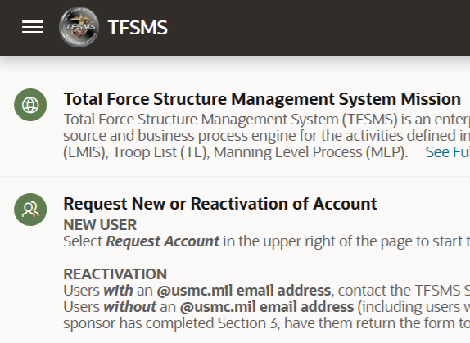
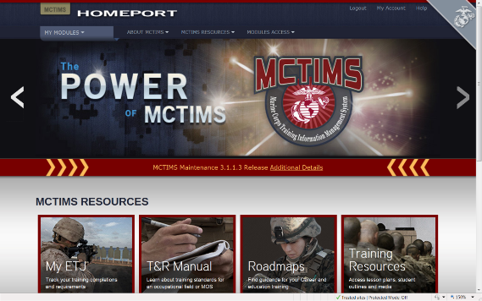
MET Data Alignments within
ADS Systems Interfaced to DRRS
Personnel Standards - T/O - Critical MOS
AAV BN T/O Critical MOS | MCT 1.1.2 Provide Forces | MCT 1.4.1.1 Conduct Breaching Operations | MCT 1.6.1 Conduct Offensive Operations | MCT 1.6.4 Conduct Defensive Operations | MCT 1.12.1 Conduct Amphibious Operations | MCT 5.3.2 Establish Means to Command and Control
1803 AAV Officer | X | X | X | X | X | X
2141 Amtrac Repair/Tech | X | X | X | X | X | X
2841 Systems Repairer | X | X | X | X | X | X
0621 Field Radio Operator | X | X | X | X | X | X
Equipment Standards - T/E / MEE
MEE TAMCN | NOMEN-CLATURE | MCT 1.1.2 Provide Forces | MCT 1.4.1.1 Conduct Breaching Operations | MCT 1.6.1 Conduct Offensive Operations | MCT 1.6.4 Conduct Defensive Operations | MCT 1.12.1 Conduct Amphibious Operations | MCT 5.3.2 Establish Means to Command and Control
B1315 | Launcher, MK-154, MOD 1 |  | x
E0796 | AAV, AAVC7A1 | x |  |  |  |  | x
E0846 | AAV, AAVP7A1 | x | x | x | x | x | x
Mission Statement and T/O&E support a unit’s chosen METs
and ensures alignments and data integrity interfaced to DRRS.
Training Event Standards
TRAINING EVENTS | MCT 1.1.2 Provide Forces | MCT 1.4.1.1 Conduct Breaching Operations | MCT 1.6.1 Conduct Offensive Operations | MCT 1.6.4 Conduct Defensive Operations | MCT 1.12.1 Conduct Amphibious Operations | MCT 5.3.2 Establish Means to Command and Control
AAV-CSS-7002 Conduct Recovery/Evacuation OPS |  | X | X | X | X
CIED-OPS-7001 Operate in Environ w/IED Threat |  |  | X | X
AAV-CBST-5001 Support a Breach |  | X
DETAILS ON MCTIMS TASK MASTER MODULE USE IN BACKUPS

Slide 31
MCT / MET / METL Development
Results & Approvals
REVIEW WORKSHOP
CONSIDERATIONS
  CD&I / TECOM FYXX MARADMIN announces coordinated Community MET/METL / T&R Manual / TMT Reviews
    Date and Location
  Reviews are coordinated w/Principal Advisor orgs and conducted ISO Service priorities
  MCT/MET refinement/modification addresses mission or structure change, resource or training requirements, or deficiencies requiring resolution.
  Unit MCT/MET capabilities, manning and resources required to support current mission involves stakeholder coordination across echelons.
  “Future” Force Design developed METs are NOT incorporated into current Core METLs but assist TECOM in necessary experimentation, curriculum and training roadmap development.
PROCESS CONTROL
ENDSTATE
COI Mission Statement should support chosen METs. Modification coordinated between Principal Advisor & TFSD.
Workshop “data-driven” deliverables are staffed via DON / ETMS2 for O6 Principal Advisor and GO (O7) -level review.
Unit chosen “tasks” as METs w/man/train/equip standards producing outputs provides a Commander the adequate ability to build a Training Plan and to assess his unit’s METL readiness in DRRS.
GO-staffed MET/METL developed products are validated by CD&I Decision Memorandum.
TFSD MCTL Branch facilitates MCT/MET changes within MCTIMS Task Master for data interface to DRRS.
Coordination within TFSD Branches ensures COI TOECRs that may correspond to MEE captured at a METL review is synchronized within TFSMS.
CD&I’s collaborative/coordinated process codified per MCO 3500.110
Notes:
31

Slide 32
MET/METL and Training Review Deliverables Checklist & POA&M
Unit Core METs/METL Review
Choose METs and develop detailed MET standards (Baseline/Advanced capability statements, personnel, equipment, training, outputs, and amphibious readiness standards
List of Critical MOS
List of MEE TAMCNs
Core Plus MET development
Develop “Observations / Recommendations” slide for your Community
Develop Capabilities Crosswalk Map of METs to HHQ Core METL
CBRN Training Assessment Criteria
Units of Employment (if applicable)
Individual Core METLs T&R Event Code Review
Validate E-Coded events
Validate the need for additional collective or chained training events
Validate recommendations for integrated staff training events and exercises
Validate Certification requirements; MCCRE (i.e., JTF, Squadron TACAIR integration, CTF HQ)
Develop Training Crosswalk
Collective Review of all WG Products
Review WG Murder Board / Outbrief Prep; Community will provide their Leadership developed products for any final modifications prior to TFSD institutional staffing.
Staffing Process of METL Review Developed Products:
Community are required to familiarize METL WG products to their organizations [14 working days]
CD&I TFSD conducts ETMS2 O6 review [14 working days]; GO review [14 working days] and adjudication of comments.
DC CD&I Decision Memorandum validates MET/METL changes/refinements
TFSD facilitates MET/standards data updates within MCTIMS for interface to DRRS
32

Slide 33
CD&I’s MCT/MET Life Cycle Supports
GFM RFF Readiness Synchronization
D-360
1
GFM RFF/RFC - PP&O Mission Review / DRT/ Apportionment / FMF Sourcing Selection
2
MCTIMS – Task Master Module DC CD&I Validated MET/METL Products
D-180
MCTIMS Core METL Data Interfaces to DRRS
PP&O Validates MARFOR Assigned Mission or OPLAN METL and Tracks Readiness Assessments
3
4
PTP
D-30
ITX/MRX
MARFORs, ISO assigned COCOMs/CCDRs, registers FMF capability / mission resource requirements RFF / RFC to PP&O.
Approved/Validated MET/METL Review Workshop developed Core METLs and standards entered into MCTIMS and interfaced to DRRS for immediate use by FMF units.
PP&O validates Assigned Mission or OPLAN METLs to requesting MARFORs / MEFs and conducts pre-deployment unit readiness synch per mission requirements.
Necessary PTP / Exercises / Evals / Certification validations and timelines are completed and coordinated.
MCCRE
Certification
D-1
Deployment

Slide 34








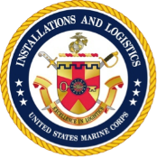

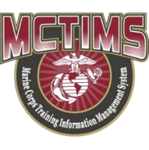

DRRS-Strategic & ADS Interfaces
DRRS-Strategic
DoW / JS / OSD - Chairman’s
Readiness System
SYSTEMS INTERFACE: JOPES / JCCA / GCSS / JWICS / DCIIN / MARMS
Joint Operational Planning & Execution (JCCA)
Global Combat Support
Joint Worldwide Intel Communications System
Joint Defense Continuity & Integrated Intel Network
Joint Mission Assurance Risk Management System
SYSTEMS INTERFACE: BIDE / GSORTS / GDSS
Basic ID Data Elements/Global Status of Resources & Training
Global Decision Support
AMSRR
(Aviation)
MC-CAMS / MARMS
USMC Installation Preparedness
NALCOMIS/
OOMA
METs/METLs
Facilities Condition
Index (MILCON)
NIPR – UNCLASSIFIED
ADS DOMAIN INTERFACE
SERMIS
GCSS
(Equipment)
RFF / RFC
Unit METLs
TFSMS
T/O & T/E
MCTFS
(Personnel)
UNCLASS MCTIMS Task Master Module Unit METs/METLs
UNCLASS TFSMS T/O&E
Notes:
AMSRR: Aviation Management Supply and Readiness Reporting (CLASSIFIED)
SERMIS: Support Equipment Resources Management Information System (UNCLASS). SERMIS is the primary automated management
information system supporting the Aviation maintenance material readiness List (AMMRL) program, as well as, Navy and Marine Supporting equipment.
NALCOMIS: Naval Aviation Logistics Command Management Information System
OOMA: Optimized Organizational Maintenance Activity

Slide 35

DC PP&O’s
Institutional Readiness
Working Group (IRWG)
Purpose: Forum employing existing USMC processes, to address current/future institutional readiness and provide recommendations for mitigation when imbalances impose Risk-to-Force or Risk-to-Mission.
Endstate: Facilitates a unified approach to informing Senior leaders in the areas of institutional readiness and ensures MC maintains a sustainable “Ready Force” to meet OPLAN demands.
Current Support: Force Synch.Conf, Force Mgmt Summit, Quarterly Readiness (QRB) to the CMC.**
Future Support: Determining predictive and forecasted readiness challenges to satisfy CMC’s prioritized guidance for Future Force Design implementation.
Membership: All DCs, MARFORs, MEFs, LOGCOM, MCICOM, DIRINT, DIR-C4, CG TECOM and MARCORSYSCOM. CDD/COPS & TFSD/OPS and MCTL Branch Lead AOs.
Method:
Monthly AO, O-6, and ESG-IRWG (1-Star GO) Meetings or SVTC to address issues, actionable items and develop/review/refine information, COAs and mission risk slides for the QRB to the CMC.
Director CDD is 1-Star GO Representative on ESG-IRWG.
**Data presented validates current unit readiness or illustrates shortfalls requiring future force solutions and mitigation strategies with institutional commonality.
35

Slide 36
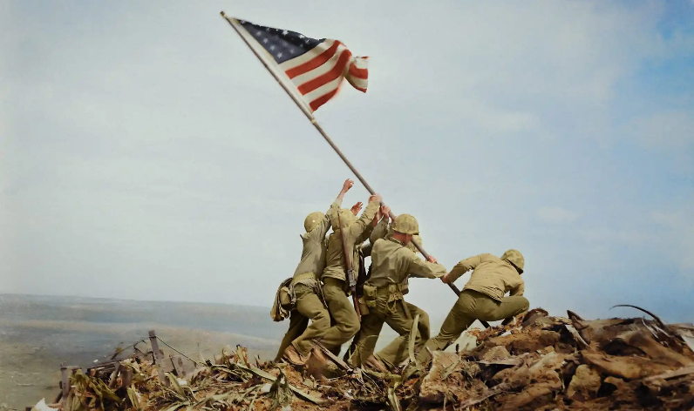

MCTL Branch Support
MCTL / METL Products
Marine Corps Training & Information Management System (MCTIMS) Task Master Module:
https://mctims.usmc.mil/TNRManual or https://mctims2.usmc.mil/
HQMC Combat Development and Integration:
https://www.cdi.marines.mil/Units/CDD/Marine-Corps-Task-List/
Total Force Structure Management System (TFSMS):
https://tfsms.mceits.usmc.mil/TFSMSPortal/faces/Home
MCTL Branch Head
Maryroi Goldman, CIV-GS14
Total Force Structure Division
HQMC CD&I / CDD
(703) 432-8460 maryroi.goldman@usmc.mil
maryroi.goldman@usmc.smil.mil
MCTL Branch Program Assistant
Mario Martinez, CIV-GS13
Total Force Structure Division
HQMC CD&I / CDD
(703) 784-6240
mario.a.martinez2@usmc.mil
mario.martinez@usmc.smil.mil
MCTL Branch Program Assistant
James Martin, CIV-GS13
Total Force Structure Division
HQMC CD&I / CDD
(703) 784-6046
james.e.martin@usmc.mil
james.e.martin@usmc.smil.mil
MCTL Branch Program Assistant
Michael Aguirre, CIV-GS12
Total Force Structure Division
HQMC CD&I / CDD
(703) 784-6085
michael.a.aguirre.civ@usmc.mil
michael.a.aguirre.civ@usmc.smil.mil

Slide 37

BACKUPS
MCTIMS TASK MASTER MODULE USE
MSHARP MODULES
DRRS-P Levels 101

Slide 38

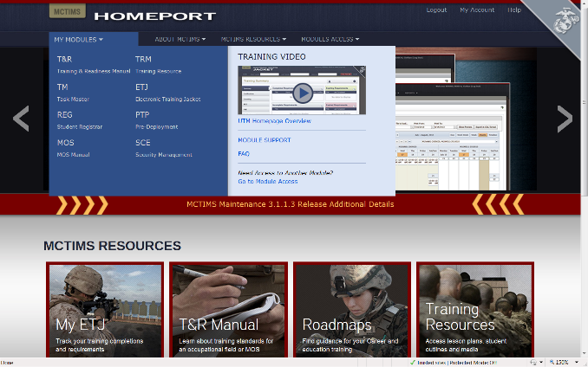
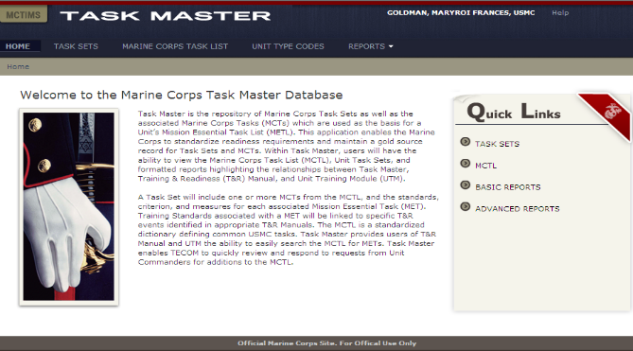
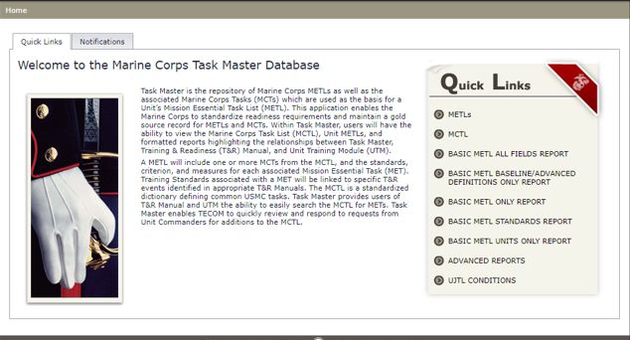
MCTIMS Task Master
ADS for MCTL / METs / METLs
MY MODULES
TM
TASK MASTER
38

Slide 39
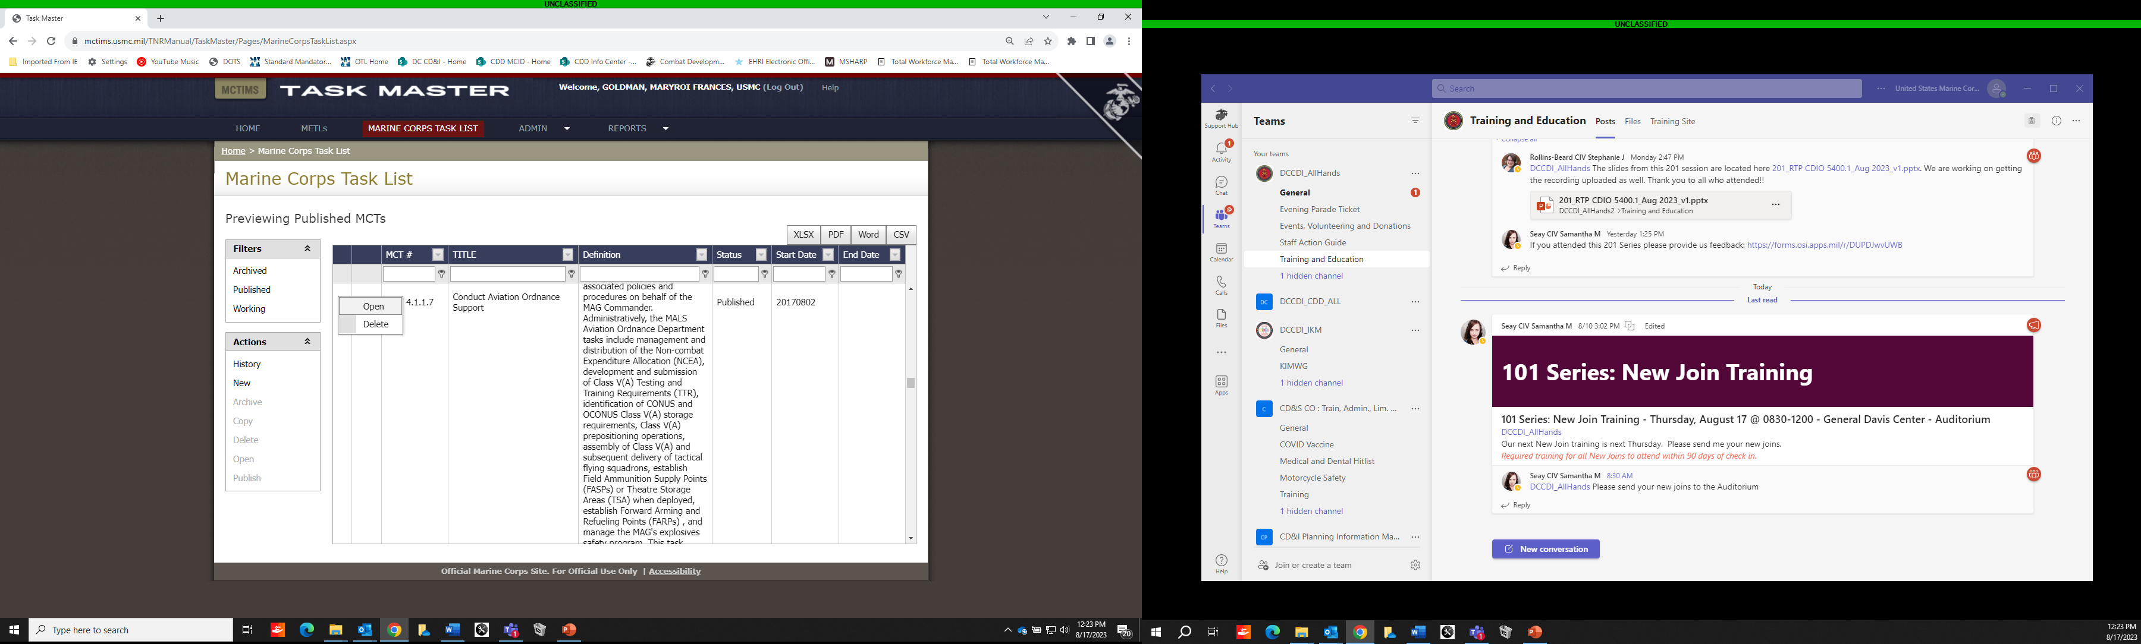
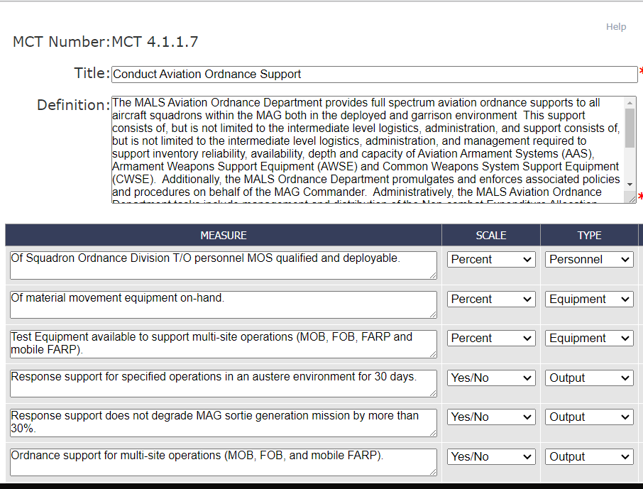
MCTIMS Task Master
Marine Corps Task List

Slide 40
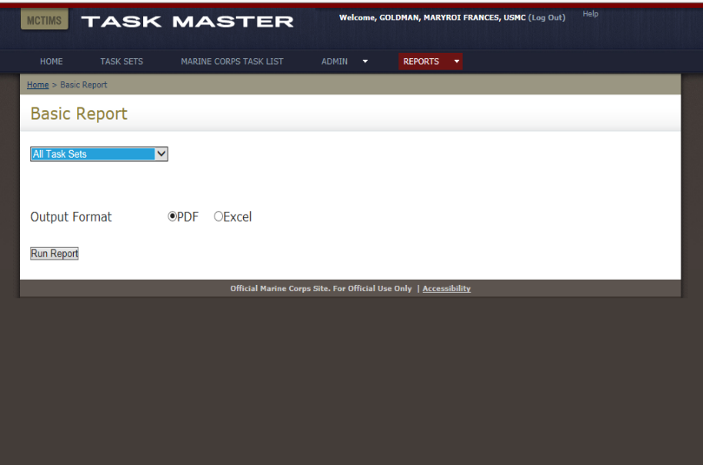
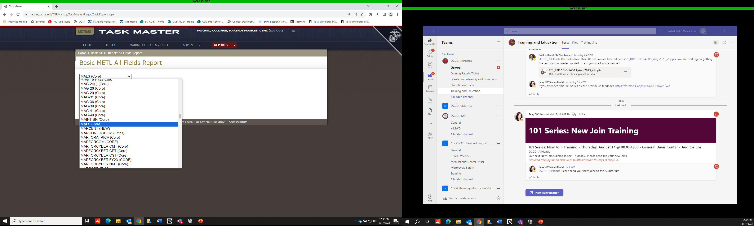
MCTIMS Task Master
Task Sets/METLs / Community Reports

Slide 41
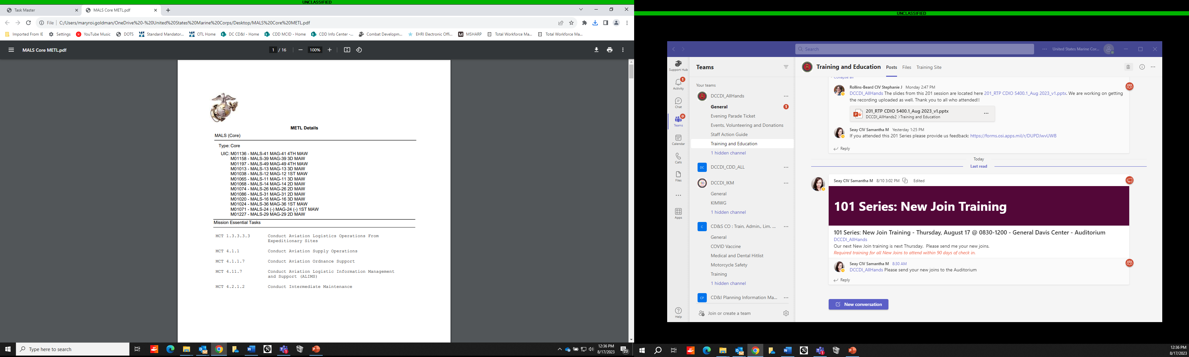

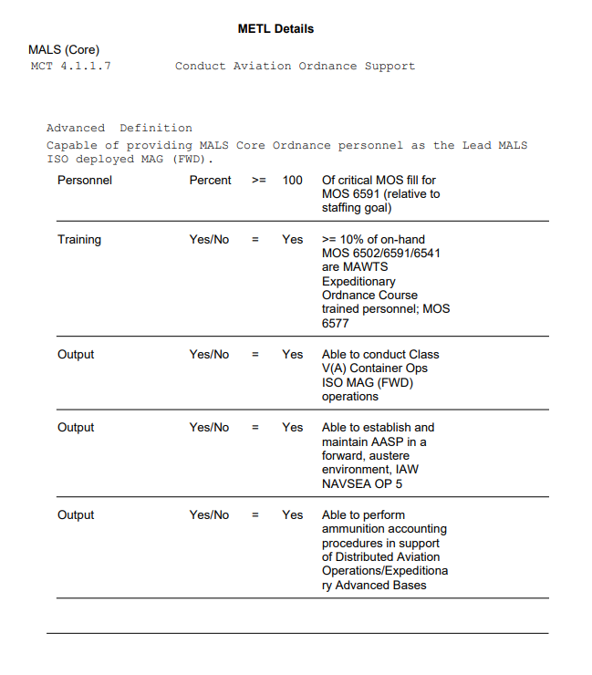
METL Reports
Org UIC / METL / MET Summary:
Baseline/Advanced Capability Statement,
Personnel, Equipment, Training and Output

Slide 42
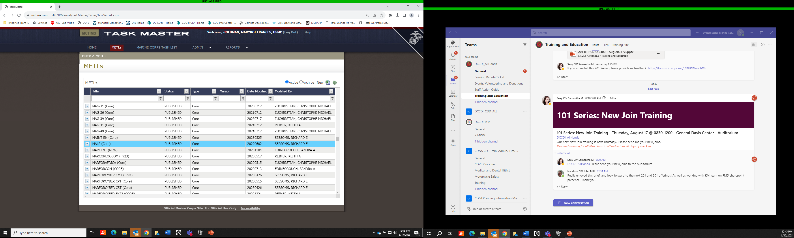
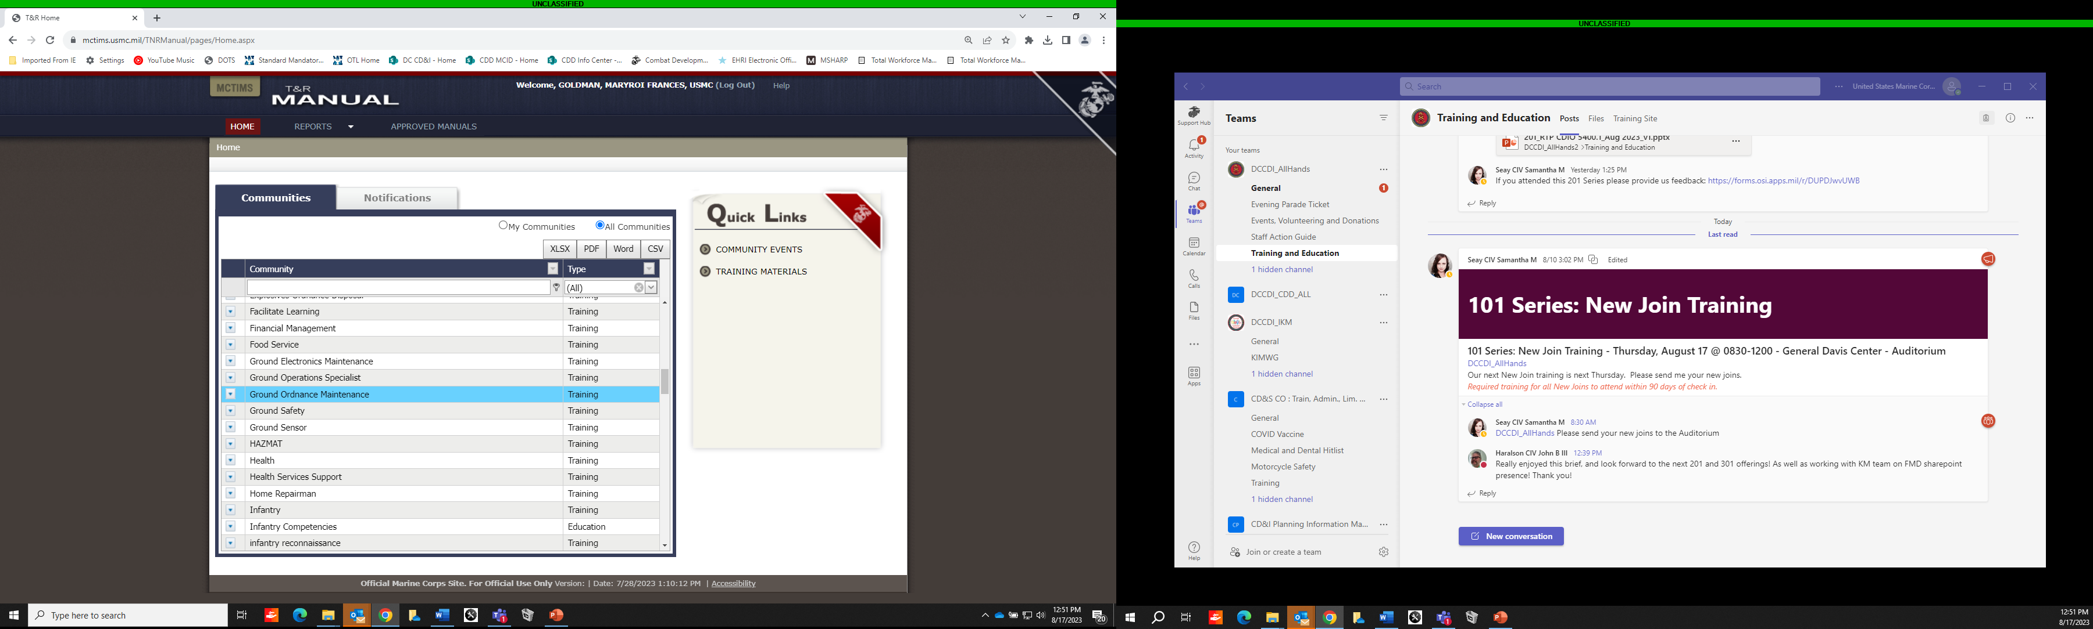
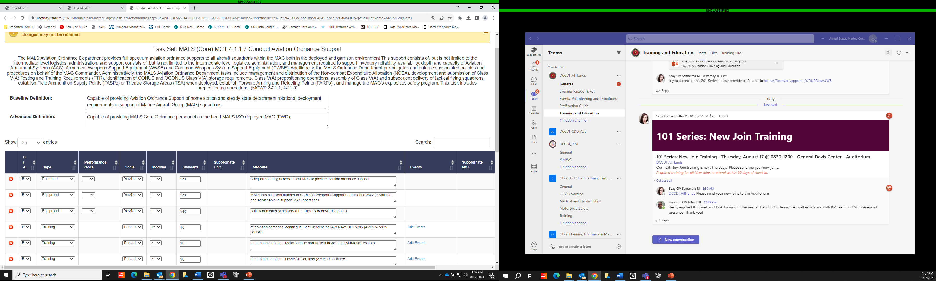
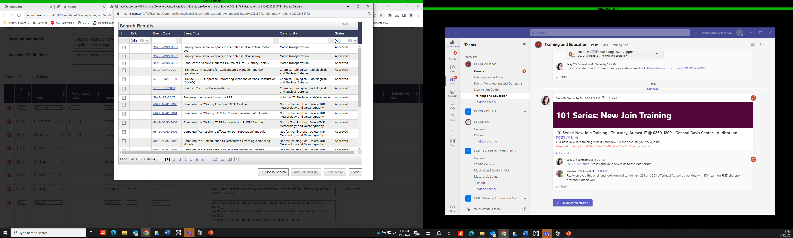
MCTIMS Task Master
Task Sets/METLs, T&R Manual,
Community Training Events

Slide 43
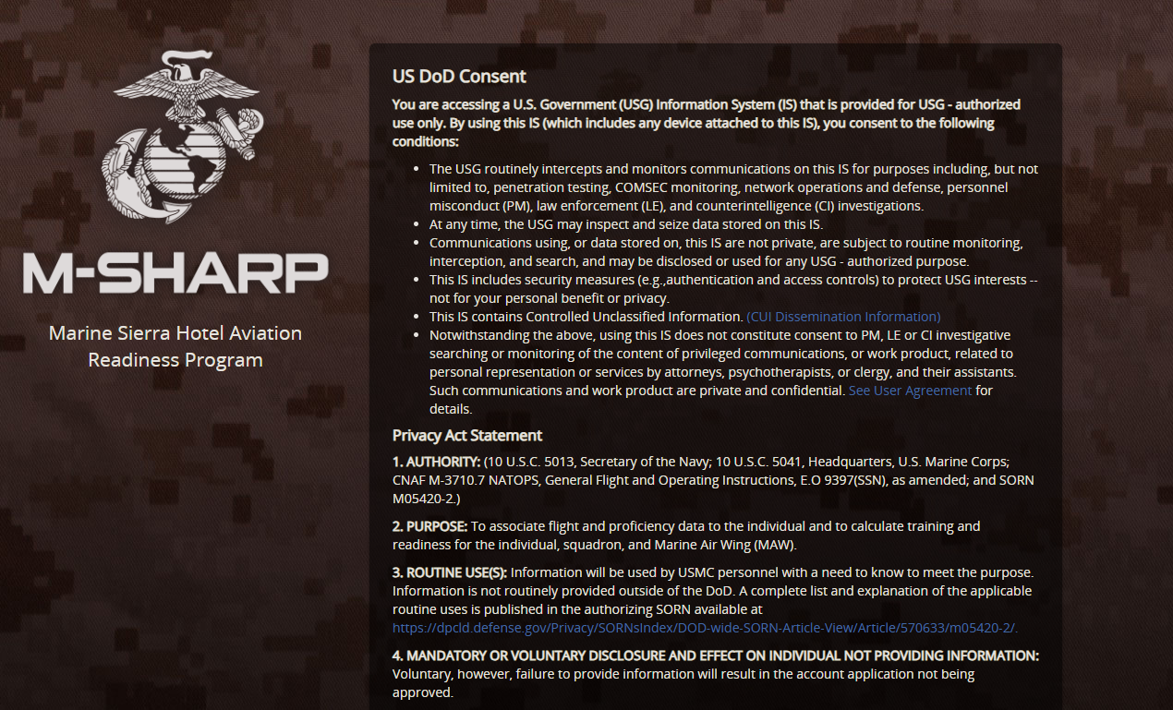
M-SHARP
USN/TECOM Aviation Training & Readiness System

Slide 44
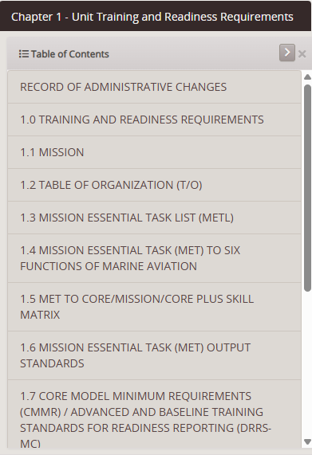
M-SHARP NAVMC 3500.50F (Published)
EX: VMFA (F18)
Mission:
Tactical and Reserve SQD/Unit
Support the MAGTF commander by destroying surface targets and enemy aircraft, and escorting friendly aircraft, day or night, under all weather conditions during expeditionary, joint or combined operations.
Mission:
Fleet Replacement SQD/Unit/FRD
Train Naval Aviators and Naval Flight Officers in FA-18 1000 phase core skill introduction basic, refresher, modified refresher, and conversion periods of instruction in order to meet Fleet Marine Force and Naval Air Forces operational manning requirements.

Slide 45
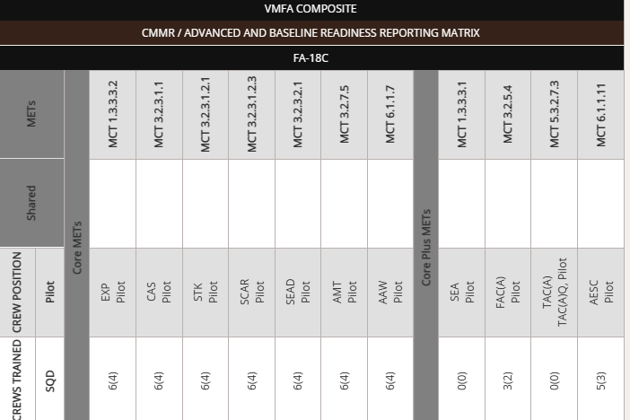
M-SHARP Baseline Training Standard
(FA-18C/D)
The level of readiness expected from a unit sustained through core training at home station. Normally equates to approximately 70% of CMMR.
In the matrix below the first number in the “crews trained” columns reflect the CMMR or advanced training standard. The numbers in parentheses indicate the baseline training standard.

Slide 46
Aircraft Readiness Calculation
Marine Corps (ARC-M)
ARC-M is developed using current Budget Exhibits, Training and Readiness Doctrine and Readiness Reporting program documents.
  • Aligned to Current FY Approved OPNAV Aircraft Program Data File (APDF)
  • Meets Defense Readiness Reporting System – Marine Corps (DRRS-MC) readiness and supply requirements for Aviation
➢ Achieve and Maintain T-Rating of T-2 average for all USMC Units
➢ Utilization Rates within WSPD determined rates for current life cycle
➢ Achieve HQMC, DCA defined Hours Per Crew Per Month (H/C/M)

Slide 47
ARC-M Projection Model,
MCAR, and FMCAR
100% of PAA is high S-1 (Deployed)
90% of PAA is low S-1 (Contingency)
USMC criteria (USMC AVPLAN):
• Flight Line Aircraft Required (FLAR)
  Fleet: 90-100% of PAA from APDF
  Training (FRS): The Previous FY’s “In Reporting” Avg.
  Other Aircraft (Test): 100% POAA
• MCAR
  75% of FLAR for AC Contingency and Deployed
  50% of FLAR for RC (while not activated)
  65%% of Previous FY’s “In Reporting” Avg (FRS)
  50% Other Aircraft (Test)
• FMCAR
  50% of FLAR for AC Contingency and Deployed
  50% of MCAR for RC (while not activated)
  30% of Previous FY’s “In Reporting” Avg (FRS)
  N/A - Other Aircraft (Test)
Number of aircraft required to be on the flight line (FL))
ALIGNS WITH LOW R-1
All TMS FLARs support the Production Planning Factors (PPF) calculated FRS resources required to meet the annual student throughput and curriculum requirements.
(OPNAVINST 3500.31G)
Number of aircraft on FL required to be mission capable (MC)
ALIGNS WITH LOW R-3
This is the number of aircraft needed on the FL and those required to be MC in order to be prepared for potential “Campaigning” requirements.

Slide 48
Critical MOS – DRRS P Levels
DRRS calculates the P-Level of a reporting unit based on the lower of two levels:
  The overall personnel strength based on T/O. For this calculation to yield a Personnel Strength of P-2, the unit must have 80% of personnel available (not detached) and deployable.
  The critical MOS fill, based on selected MOS. A script will look for BMOS and PMOS matches for each BIC on the T/O, generating a requirement for each selected MOS. The total fills (available/deployable) against these requirements, divided by the total requirements, yields a percentage. For this calculation to yield a P-2, the unit must have 75%. At least three MOS must be designated.
If every MOS is critical, the two calculated percentages will be equal, and the critical MOS will never be a factor because 80% is a tougher requirement than 75%. We try to avoid the added work of reporting critical MOS when doing so does not improve value of the report.
If the critical MOS list includes a High Volume MOS as well as several lower density MOS, the lower density MOS will not matter.
  Example: A unit could select a High Density MOS (30 x 0311), as well as two lower density MOS (1x 0302 and 1x0369).
  If the 30 x 0311 are filled, the unit could be 30 of 32 (94%) even if neither of the other two are filled.
  An excess in 0311 (32 of 30 x 0311 billets filled), can put the unit at 100% critical MOS fill with the other critical MOS entirely gapped.
No automatic requirement to designate the "identity" MOS for a unit as critical. No requirement to designate 0311 Infantrymen for an Infantry Battalion. [Strongly discouraged for reasons noted above.]
As a result, two best practices apply:
  1) Do NOT select a set of critical MOS that in total would represent over 50% of the unit.
  2) Do NOT select any critical MOS that represents a high volume in comparison to the other selected MOS.
Exceptions:
  1) Some units only have 3 MOS. In this case, they must select all 3.
  2) Some units have a higher density MOS with a historically low level of fill - a new MOS, a problem MOS, etc., and other MOS don't matter or are not expected to be an issue. In this case it may be worth selecting the MOS in order to focus on the main issue.
BLUF: Wherever possible, use the Critical MOS list to highlight low density MOS that would be lost in the aggregate calculation but generate disproportionate effects if not filled.

